Slide 1



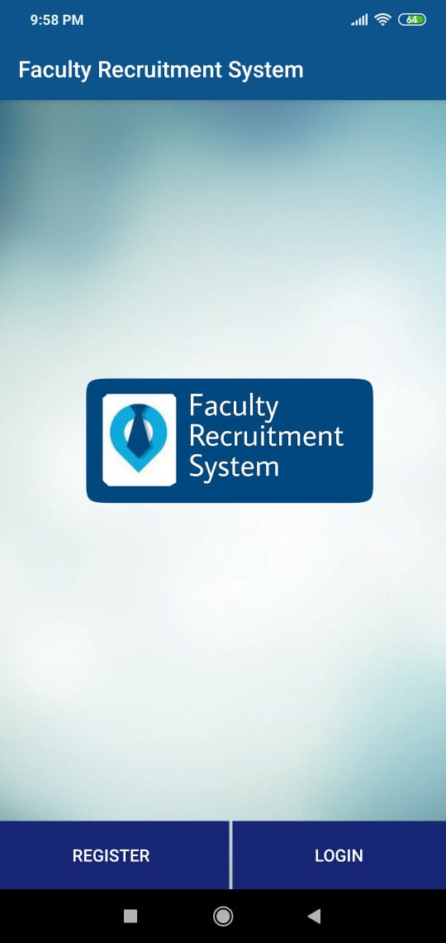
Faculty Recruitment
System

Slide 2
Team 12
Django Team :
Velagandula Nanditha-CSE-1/4
Tarun Kumar-IT-2/4
Deevana Mridhula-CSE-1/4
Mobile Team :
Slesha Adi-CSE-2/4
Nikhil Ranga-IT-2/4
Namya Reddy-CSE-3/4
Api & Database :
Tejaswini Jakka-CSE-2/4
Srihitha Reddy-CSE-1/4

Slide 3
The Problem Statement
Admin
Admin Login
Upload all the roles with vacancies in the college
Receive all applications from users
Go through the User’s qualifications and decide to approve or decline
If approve recruit for only any one post from all his/her applications
Once a faculty is recruited all the applications with respect to him should be discarded
User
Registration with uploading all the details about Education qualifications and experience
Login
Home page with list of roles that he can apply and status of previous applications
Limit number of applications to 3
Apply for a role in college with department details and preferences of subjects
Receive notifications about the updates regarding applications
User cannot apply for the same role after getting declined.

Slide 4
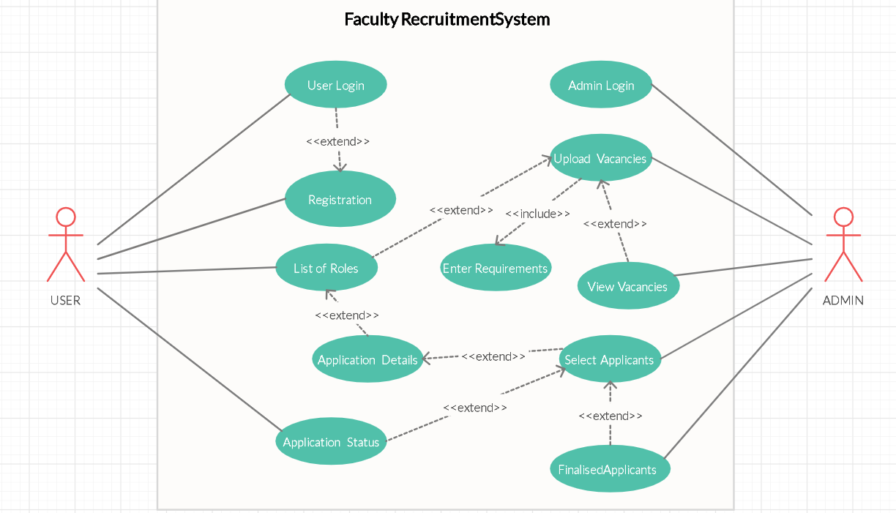
Use Case Diagram

Slide 5
WEB APPLICATION
Technologies used are
Django Python Framework
HTML ,CSS,Bootstrap,JavaScript

Slide 6
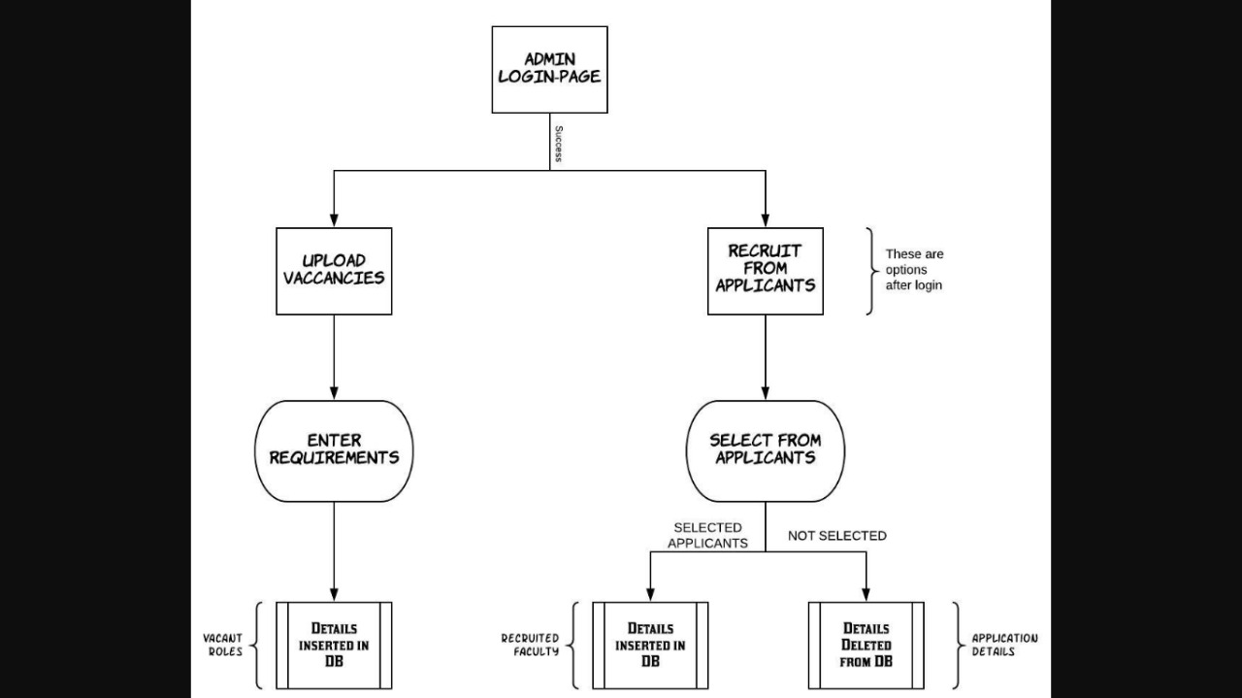
FLOW
DESIGN

Slide 7
Web Pages
Admin Login page
Options page
Upload Vacancies page
View Vacancies page
Select Applicants page
Recruited faculty page

Slide 8
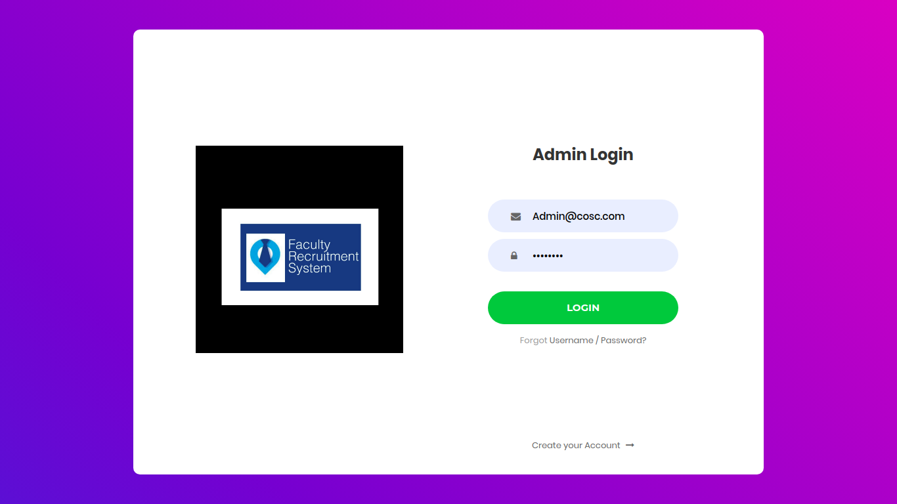
Admin Login

Slide 9
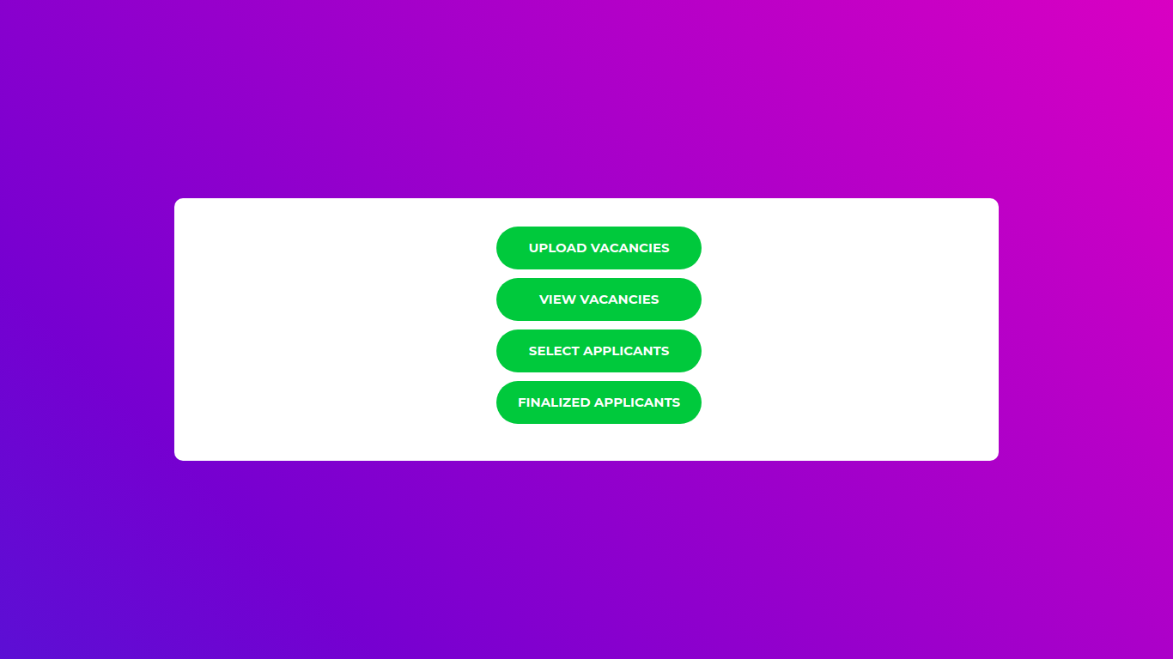
Options Page

Slide 10
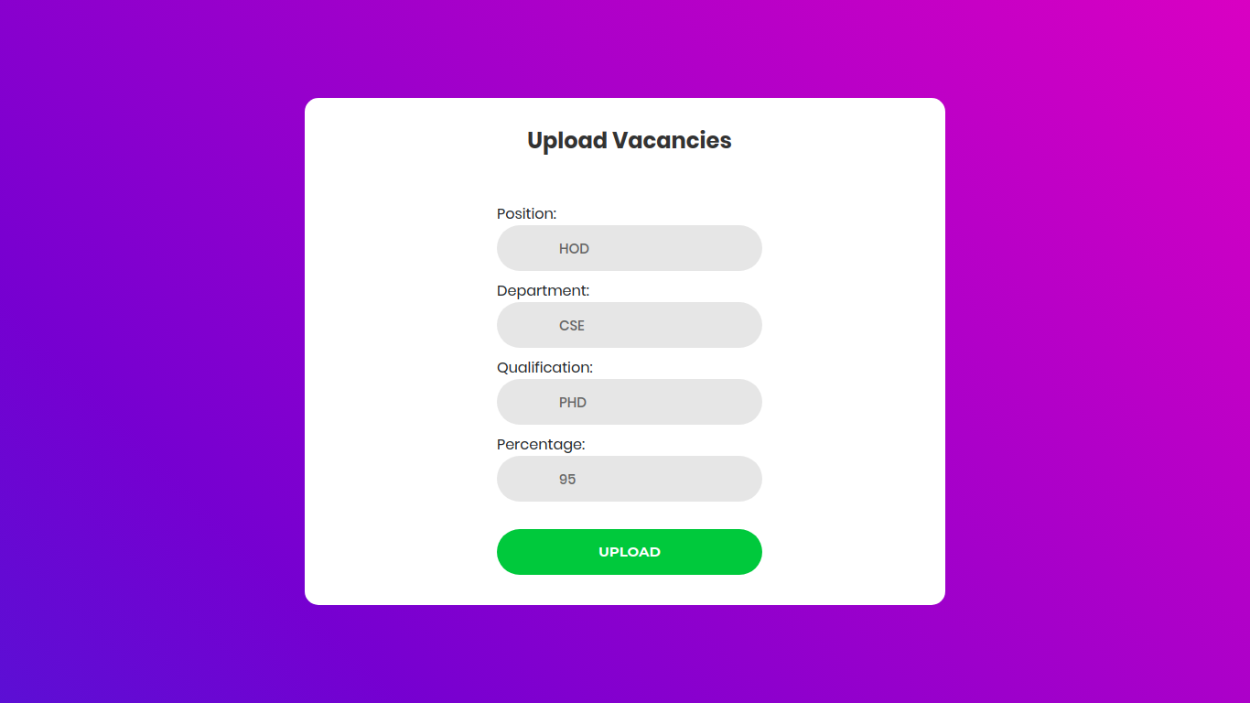
Upload Vacancies

Slide 11
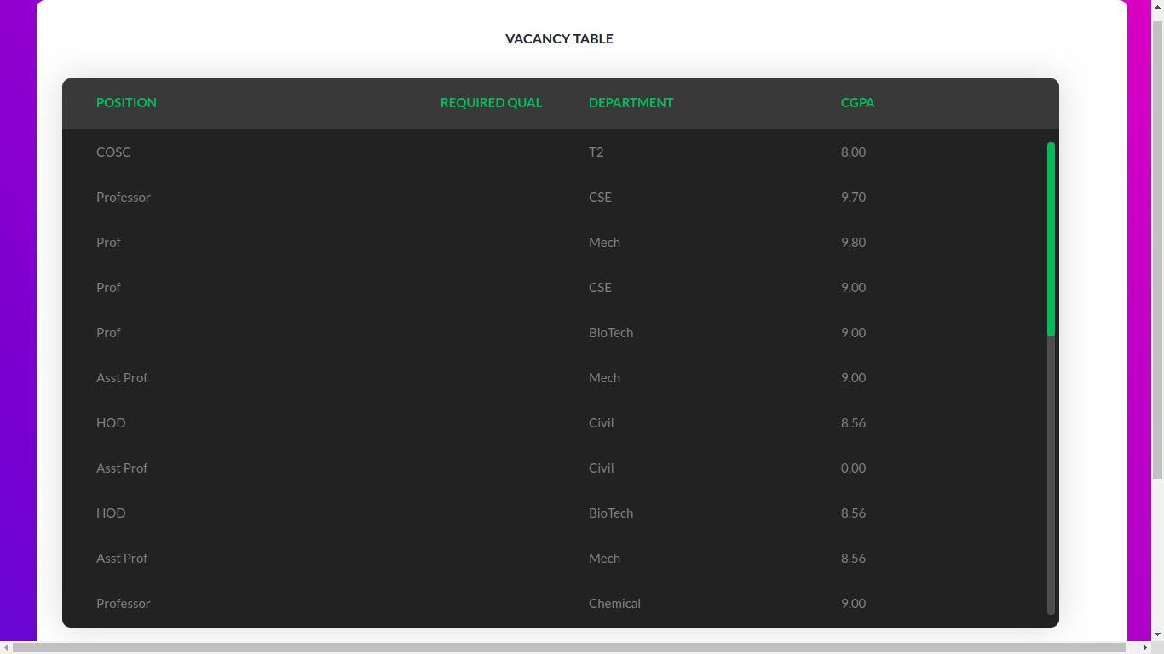
View Vacancies Page

Slide 12
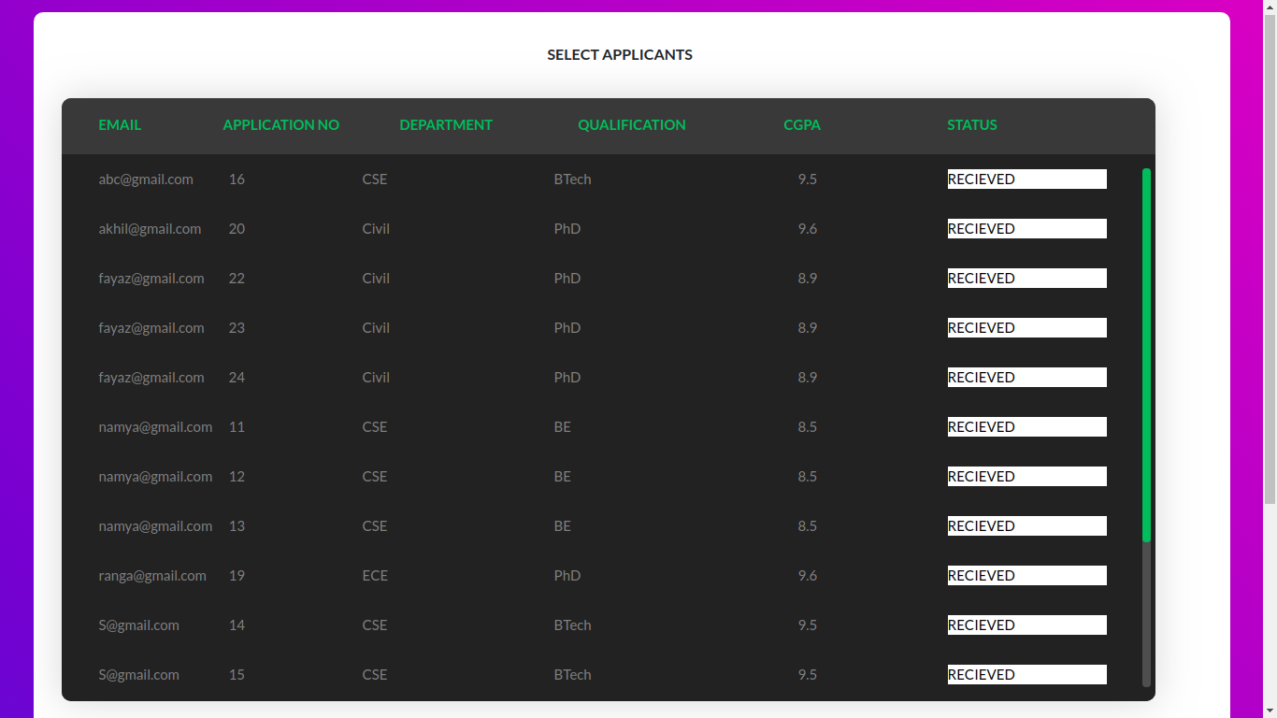
Select Applicants Page

Slide 13
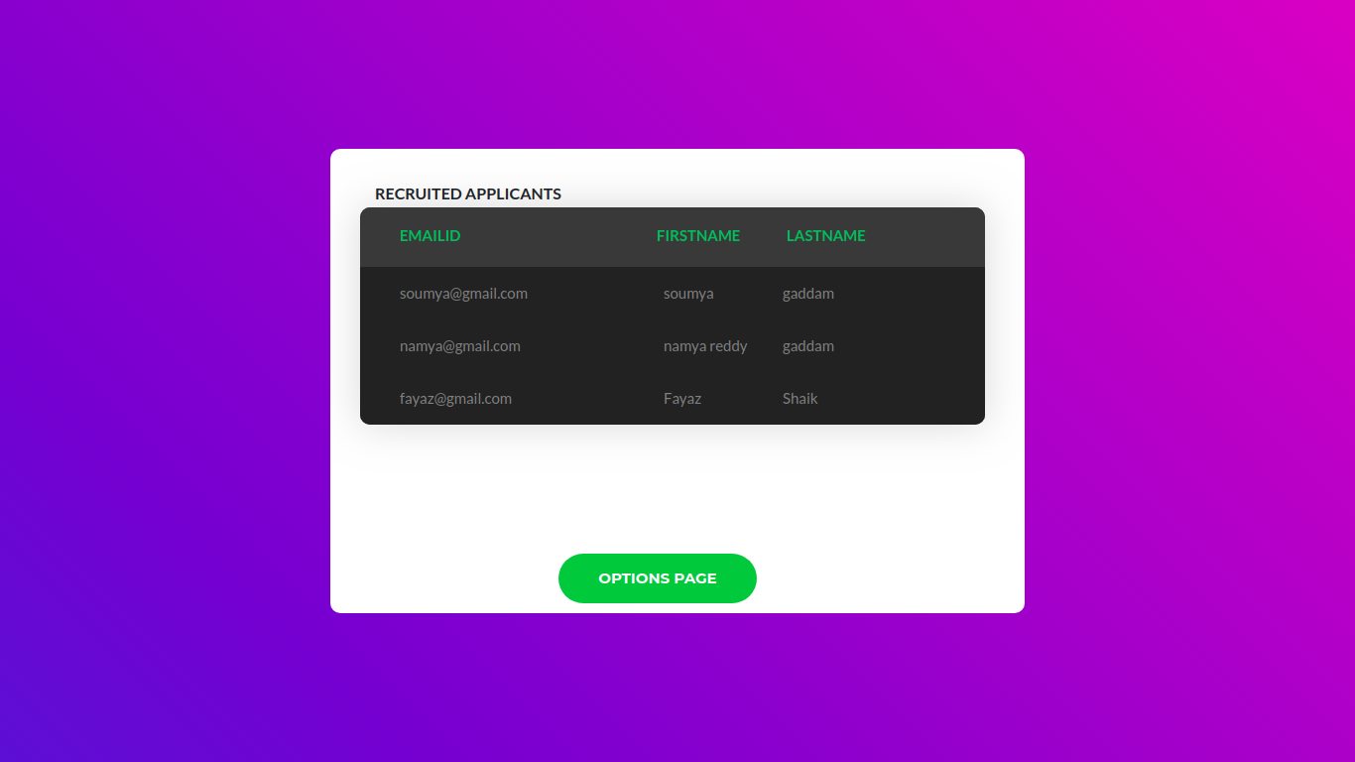
Recruited Applicants Page

Slide 14
Mobile Application Development
Technologies used:
Programming language - Java
Tool - Android Studio

Slide 15
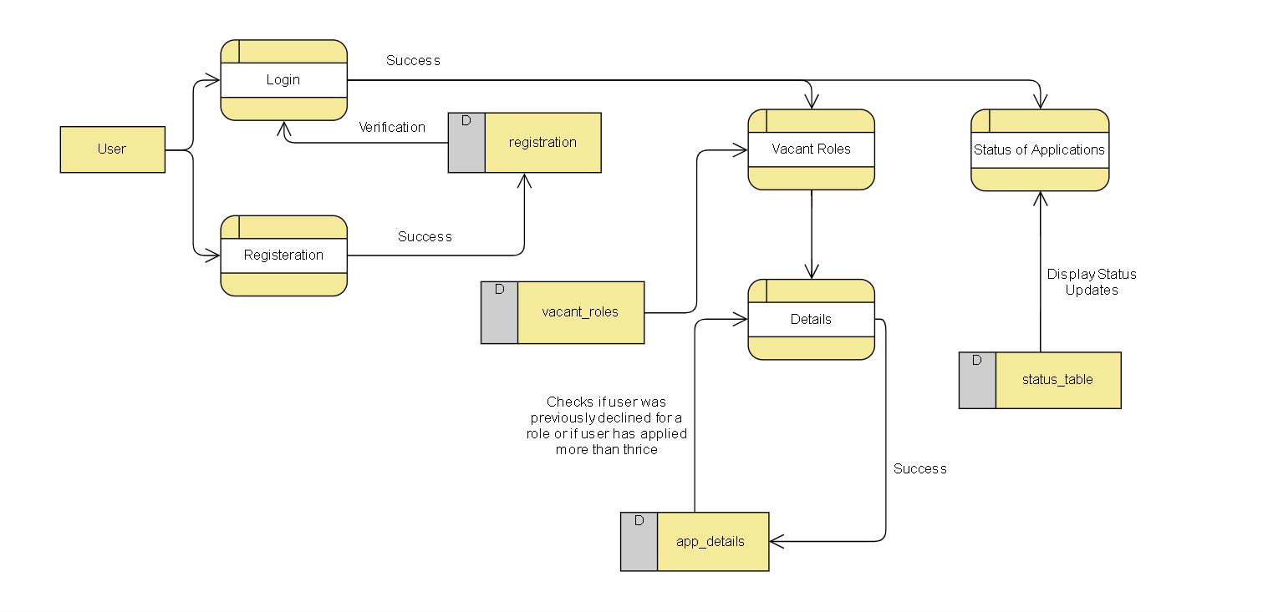
Data Flow Diagram

Slide 16
User Login page
User Registration page
Home page
Vacancies page
Application Details page
Application Status page
App Pages

Slide 17
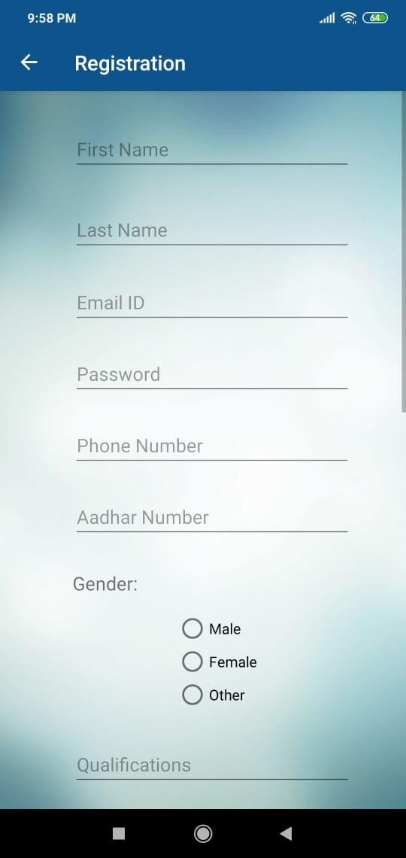
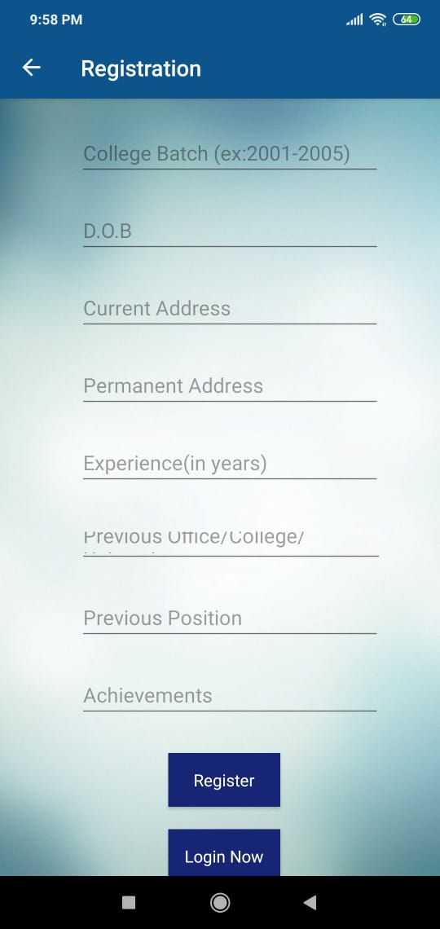
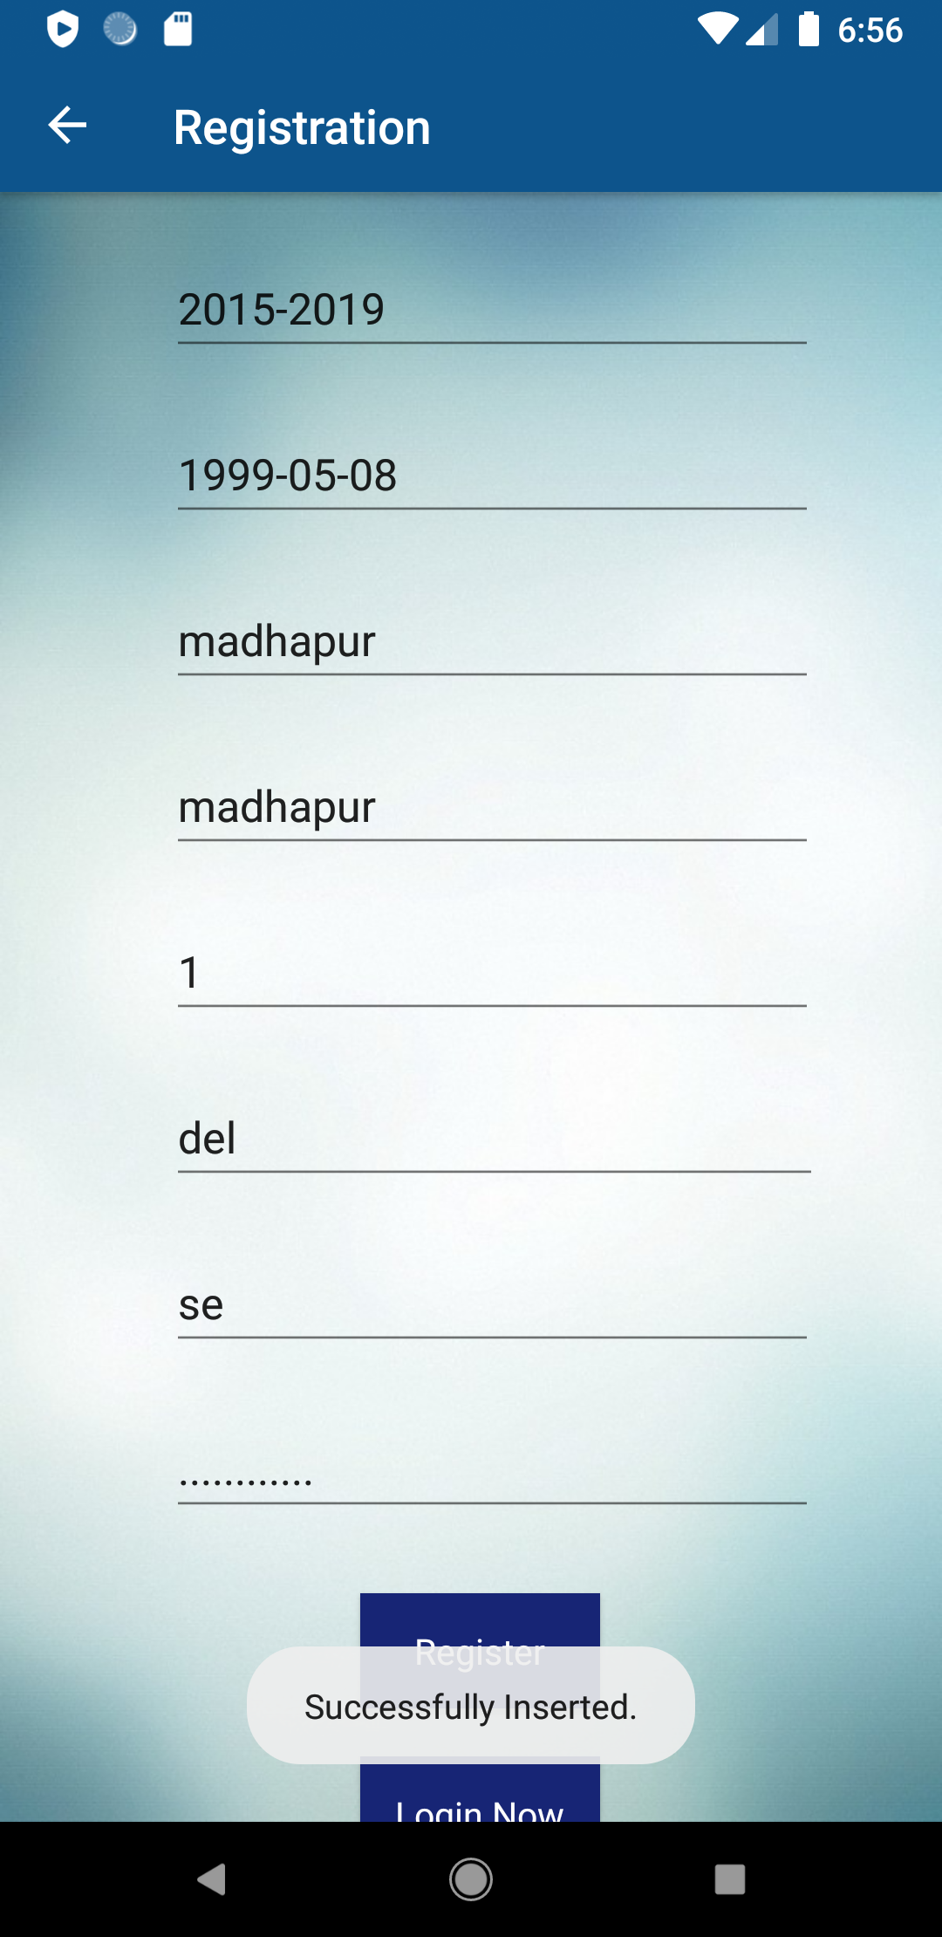
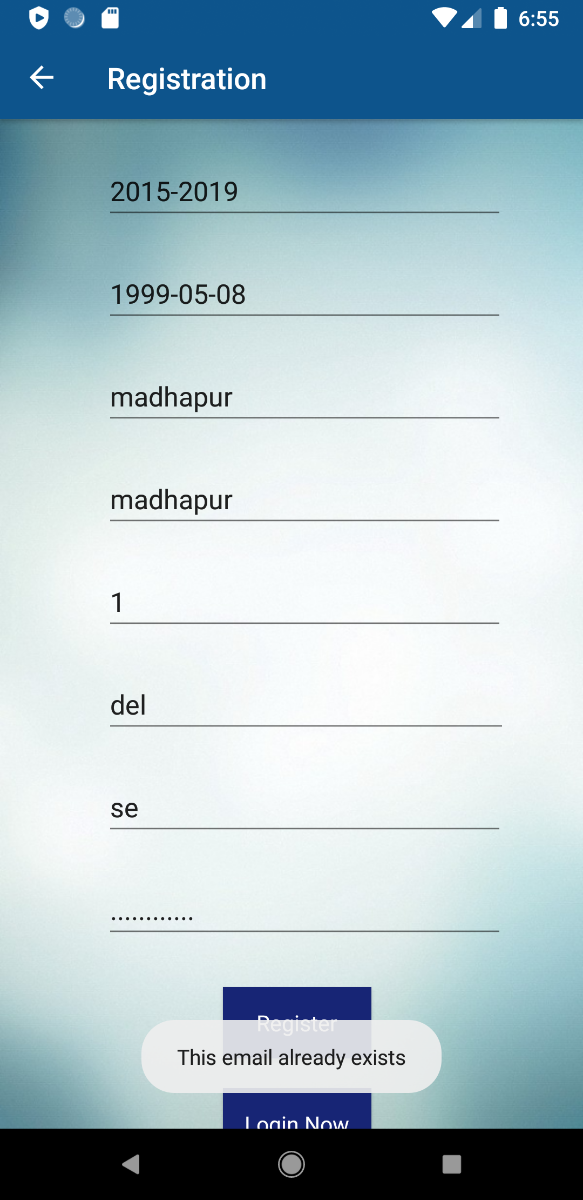
User Registration Page

Slide 18
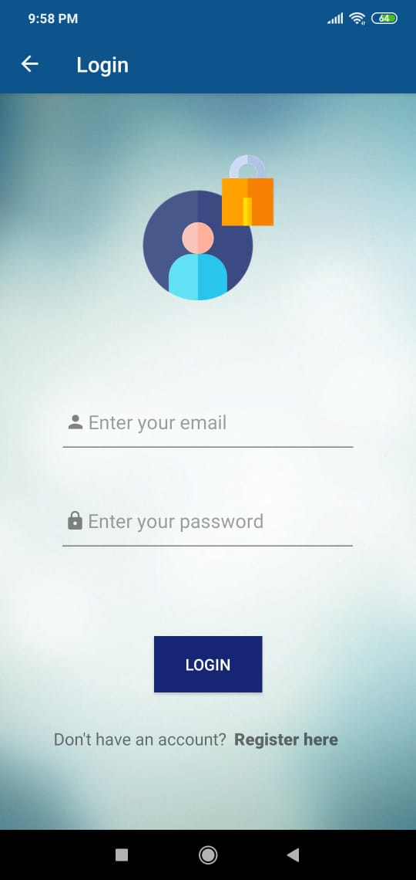
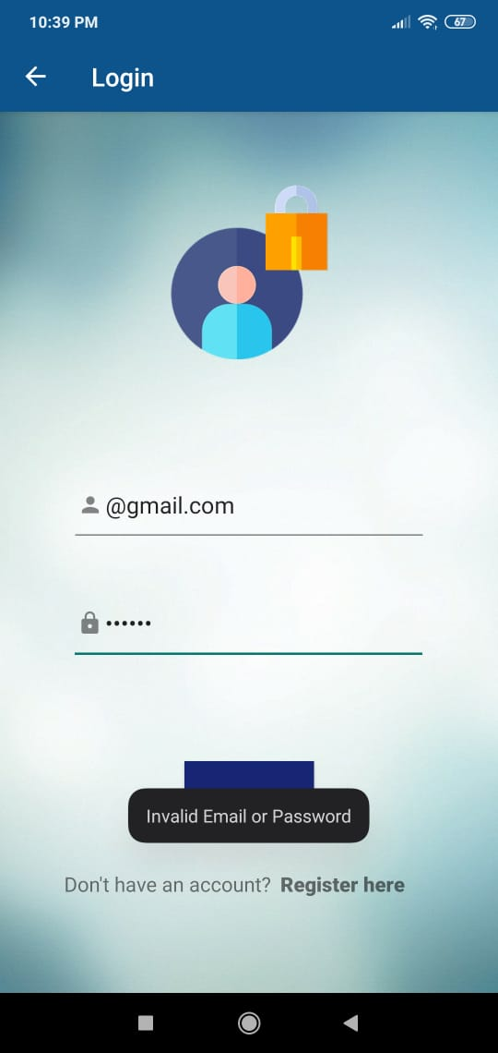
User Login Page

Slide 19
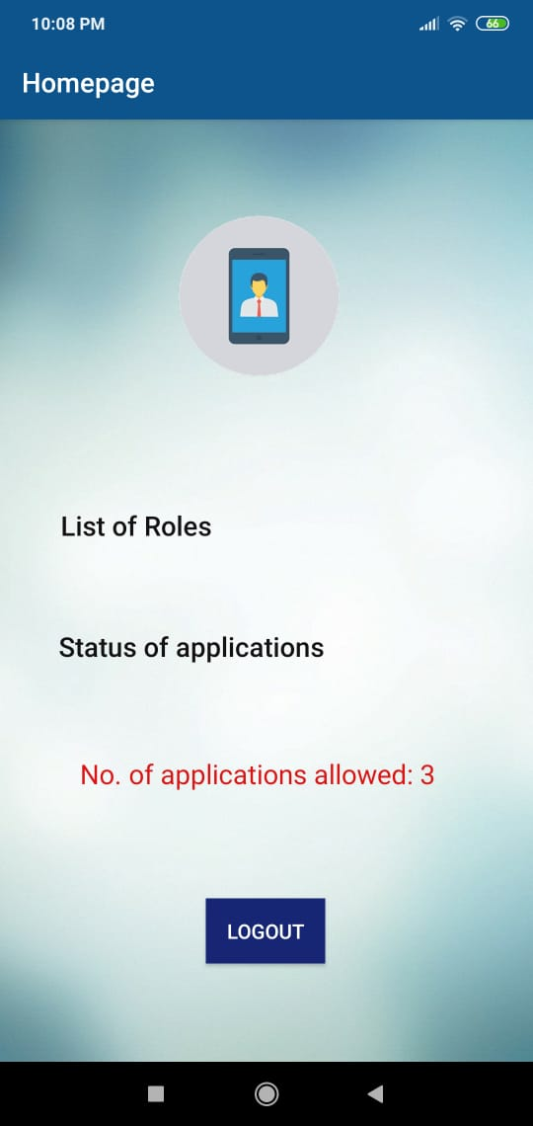
Home Page

Slide 20
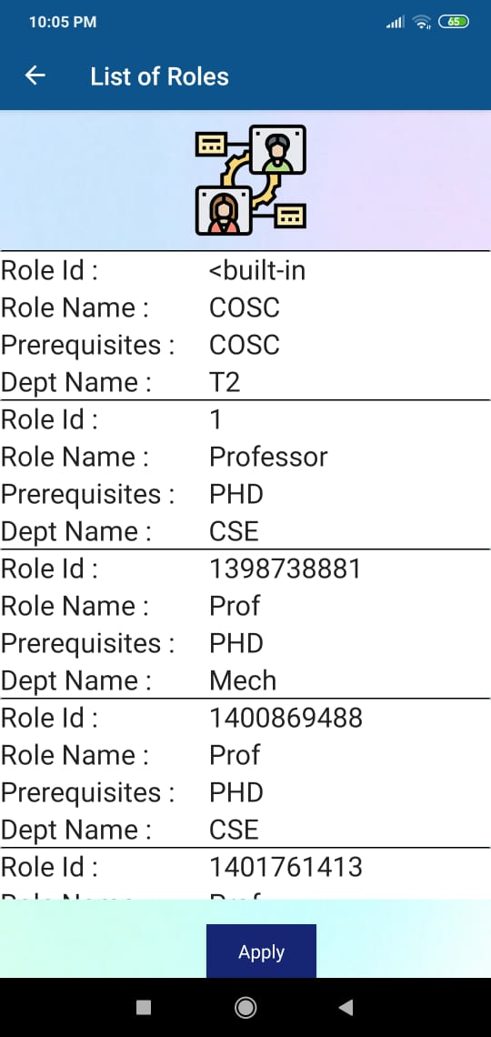
Vacant roles page

Slide 21
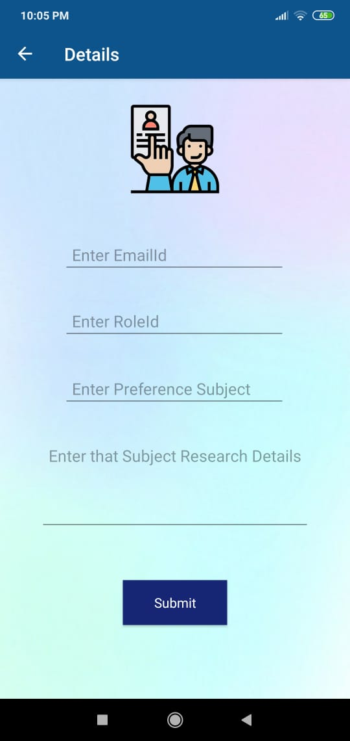
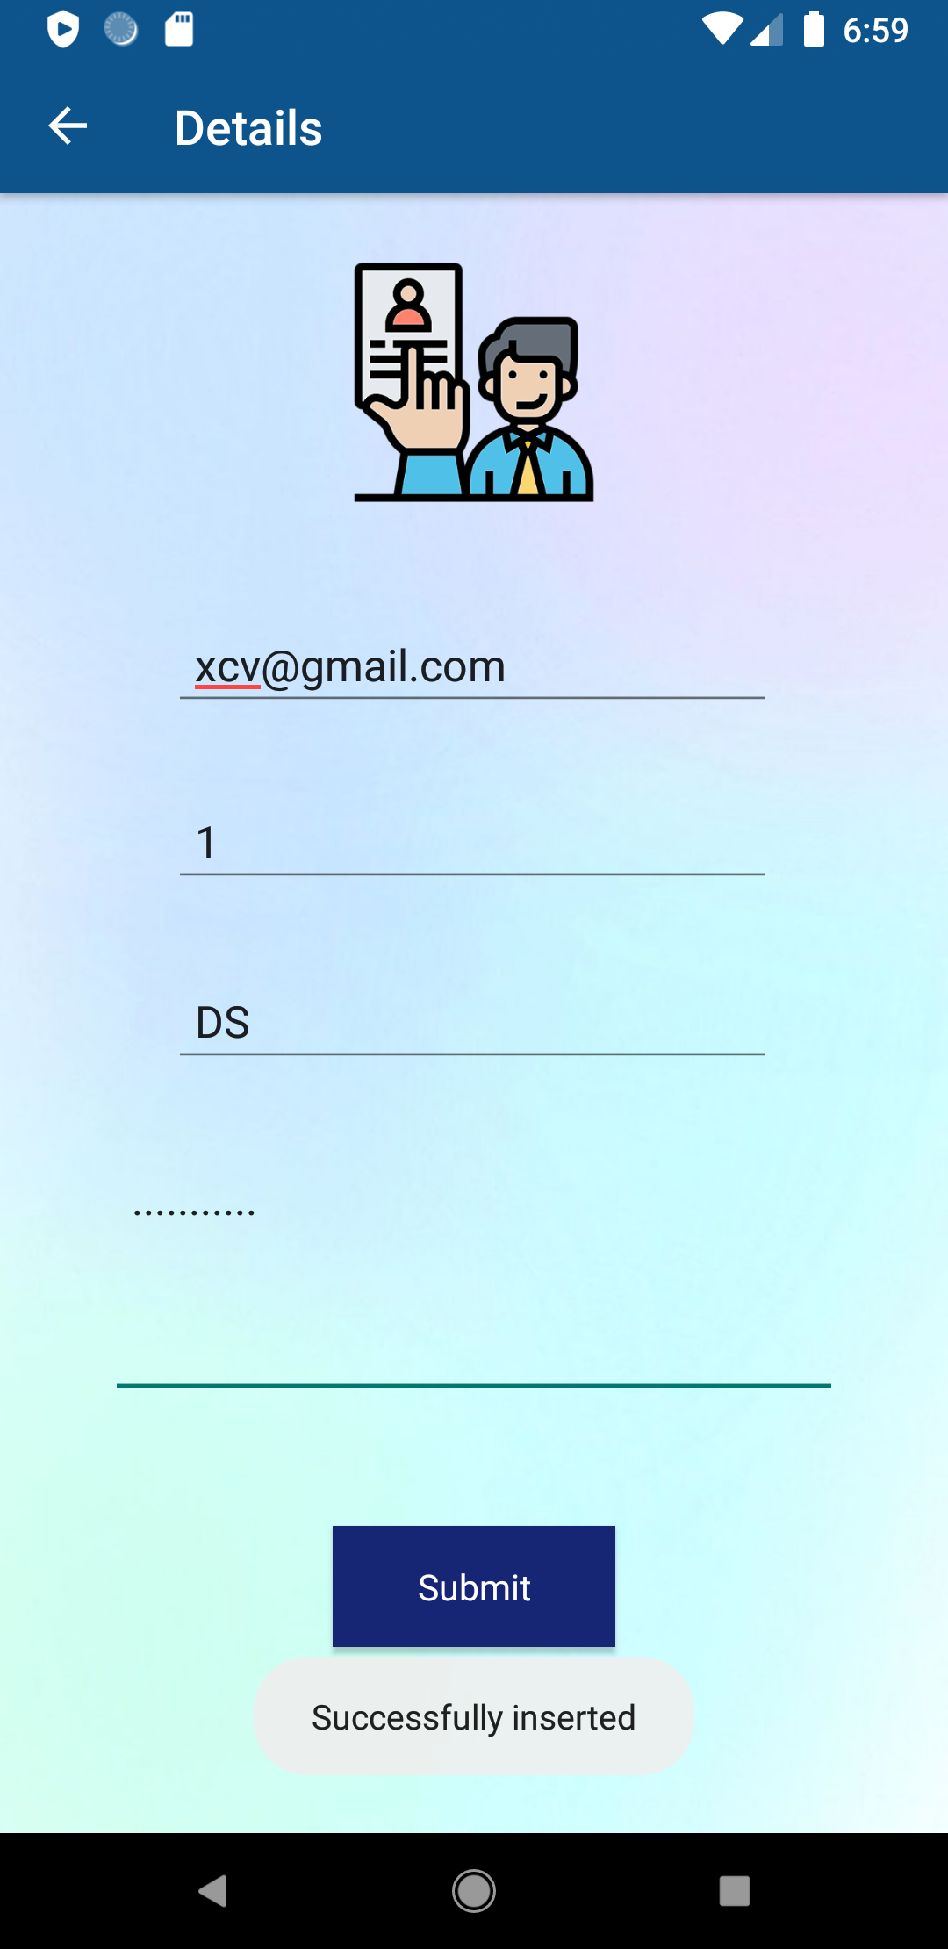
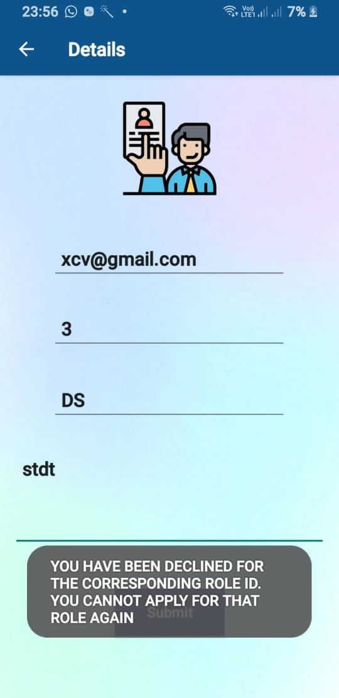
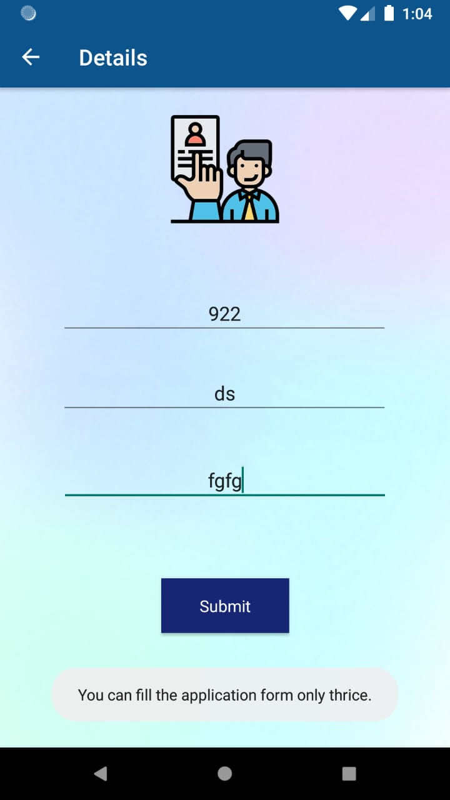
Application Details Page

Slide 22
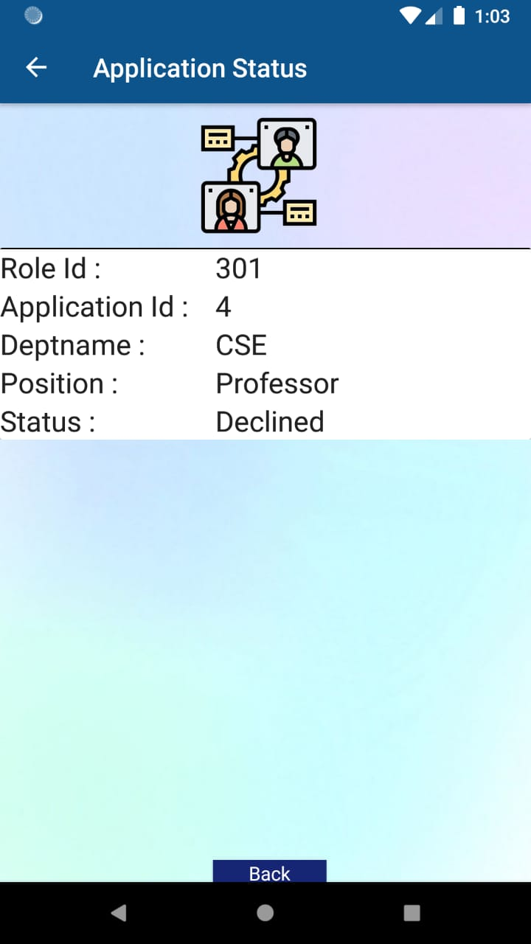
Application Status Page

Slide 23
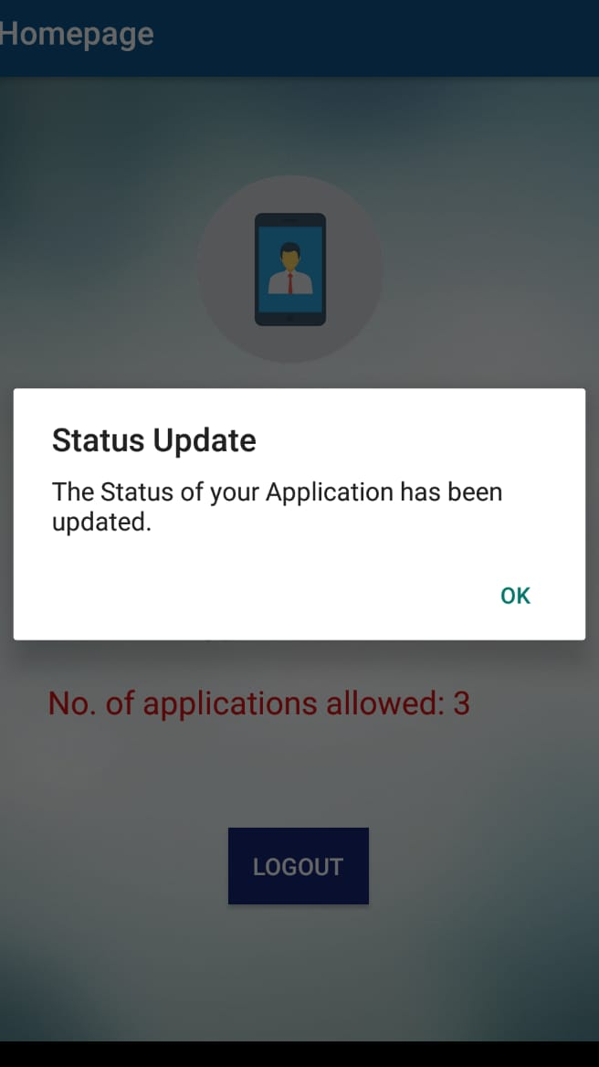
Application Status Update Notification

Slide 24
DATABASE AND APIs
PROGRESS - DB AND API TEAM:
ALL THE DATABASE TABLES AND APIs HAVE BEEN DESIGNED. REQUIRED MODIFICATIONS FOR DJANGO TEAM AND MOBILE APP DEV TEAM HAVE BEEN DONE.
LINK TO DEPLOYED APIs : https://admintesting.herokuapp.com/

Slide 25
TECHNOLOGY STACK:
Programming Languages Used
For DataBases : MySQL
For API : FLASK
Tools used
POSTMAN for testing , HEROKU for deploying

Slide 26
OUR DATABASE TABLES

Slide 27
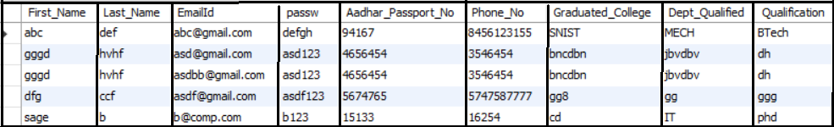
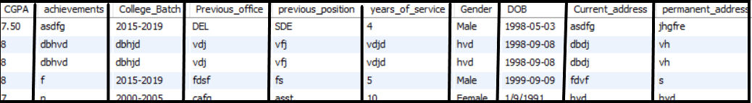
REGISTRATION TABLE

Slide 28
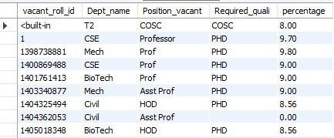
VACANT ROLES

Slide 29
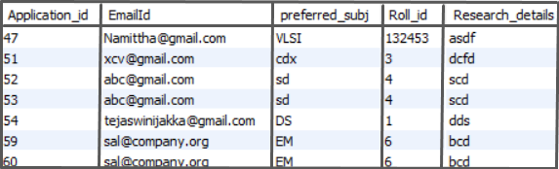
APPLICATION DETAILS

Slide 30
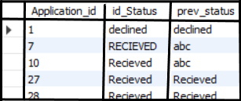
STATUS TABLE

Slide 31
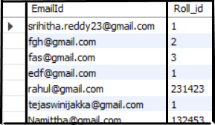

RECRUITED FACULTY
Balsamiq Tip | Information architecture is the flow of content across the site or application (more info).

Slide 32
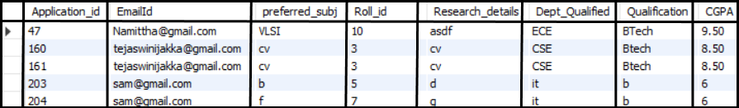
VIEW:

Slide 33
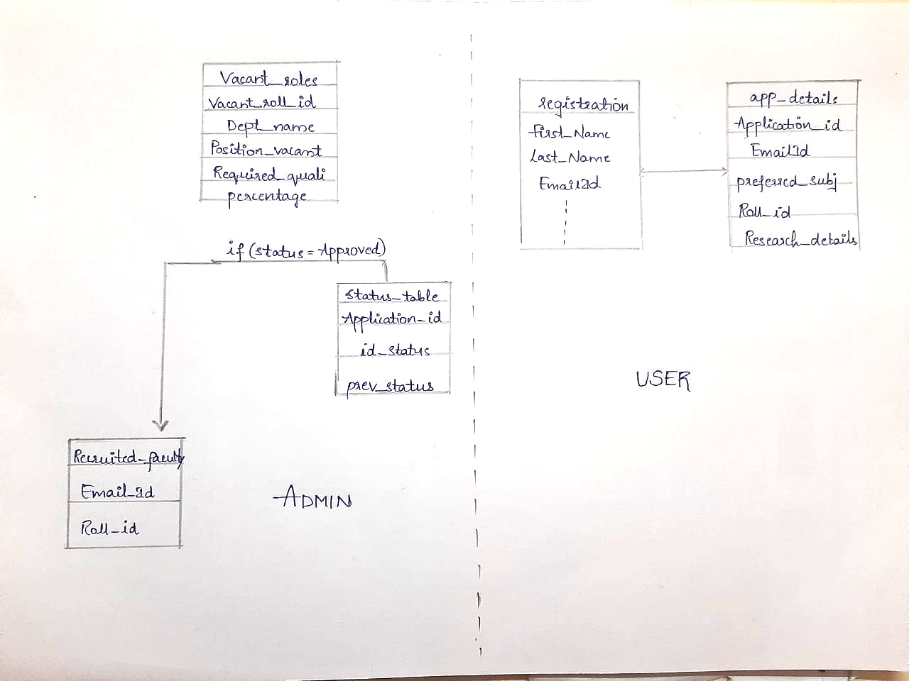
SCHEMA:

Slide 34
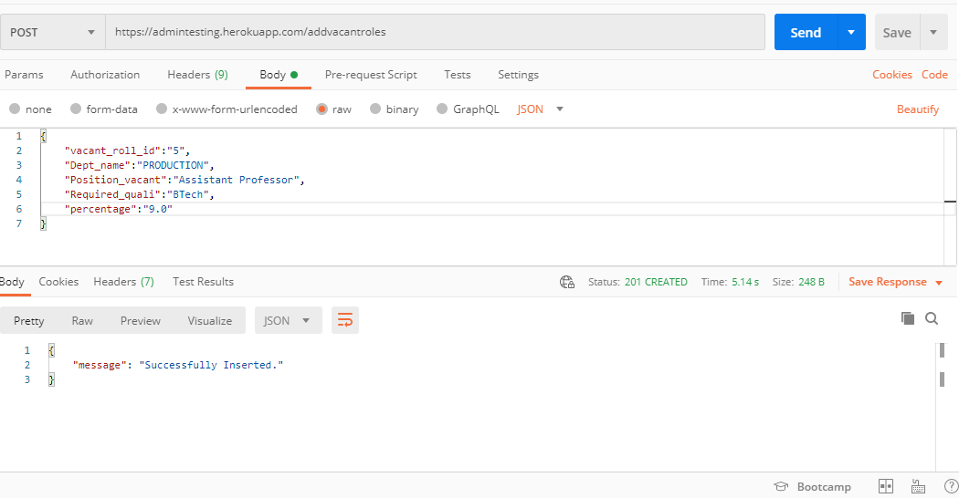
APIs
/addvacantroles : POST to VACANT ROLES Table (Admin Side)
Balsamiq Tip | Information architecture is the flow of content across the site or application (more info).

Slide 35
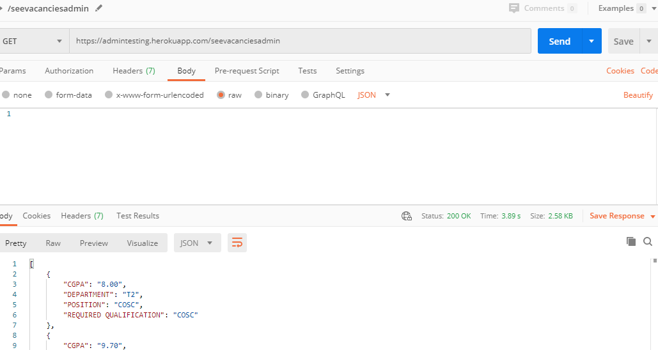
APIs
/seevacanciesadmin : GET all vacancies from VACANT ROLES Table (Admin Side)
Balsamiq Tip | Information architecture is the flow of content across the site or application (more info).

Slide 36
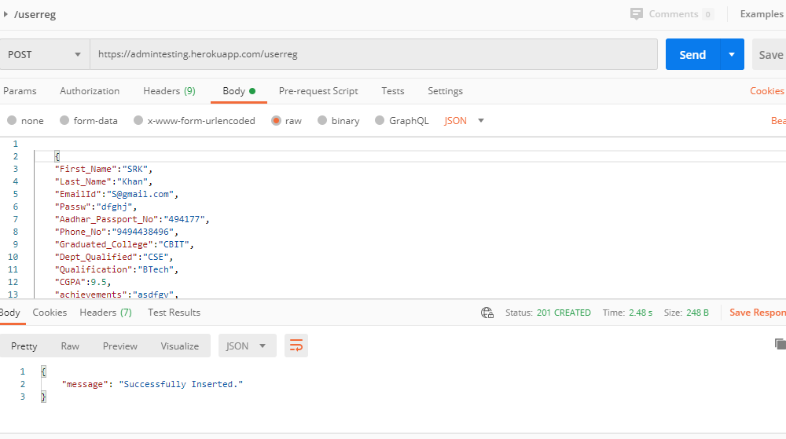
APIs
/userreg : POST to Registration Table (USER side)
Balsamiq Tip | Information architecture is the flow of content across the site or application (more info).

Slide 37
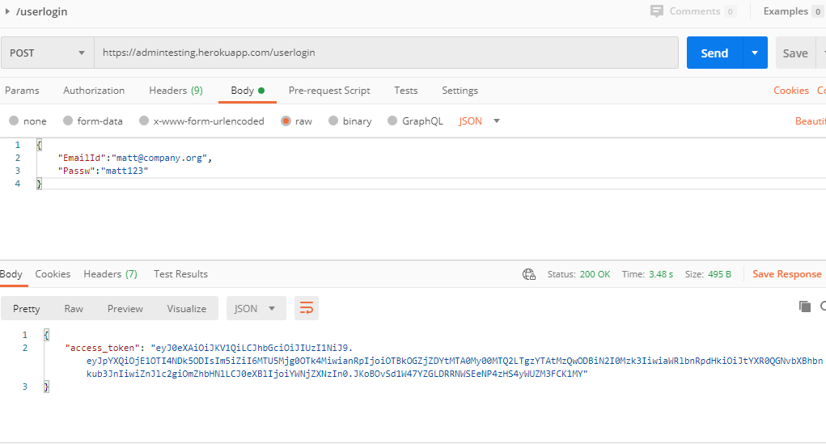
APIs
/userlogin : Takes EmailId , Password and returns JWT token, if it exists in REGISTRATION
Balsamiq Tip | Information architecture is the flow of content across the site or application (more info).

Slide 38
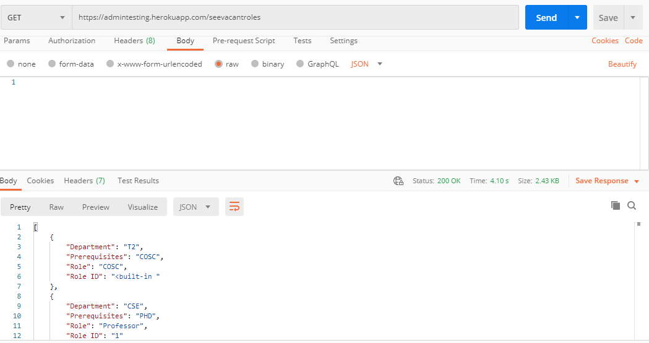
APIs
/seevacantroles : GETs all the details from VACANT ROLES for user to see vacancies.
Balsamiq Tip | Information architecture is the flow of content across the site or application (more info).

Slide 39
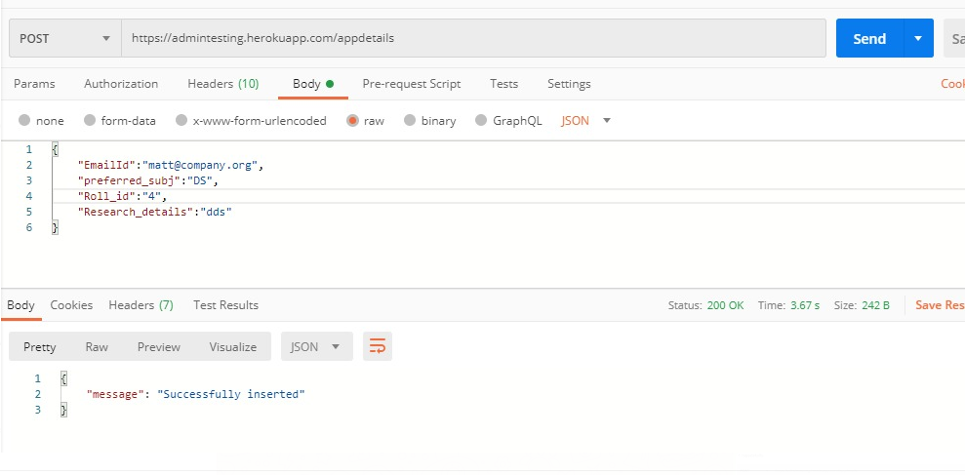
APIs
/appdetails : POST application details entered by user to the application Table.
Balsamiq Tip | Information architecture is the flow of content across the site or application (more info).

Slide 40
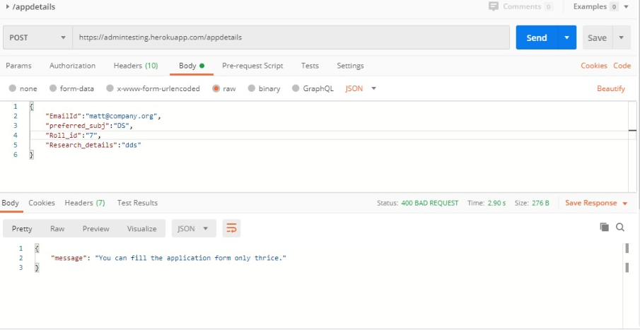
APIs
/appdetails : Continuation
Lets User enter application form only thrice.
Balsamiq Tip | Information architecture is the flow of content across the site or application (more info).

Slide 41
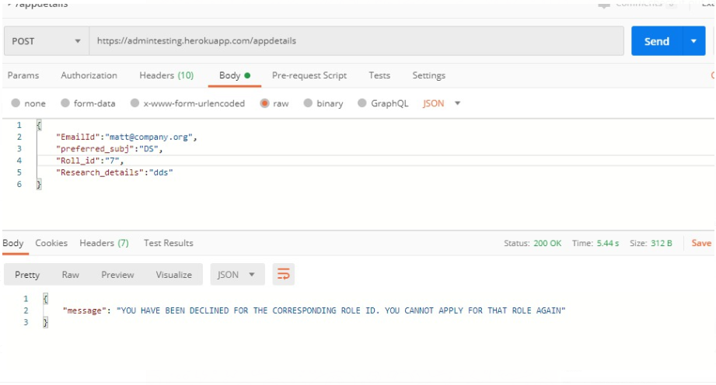
APIs
/appdetails : Continuation
Does not let User enter application form for the same Role, if he was declined previously.
Balsamiq Tip | Information architecture is the flow of content across the site or application (more info).

Slide 42
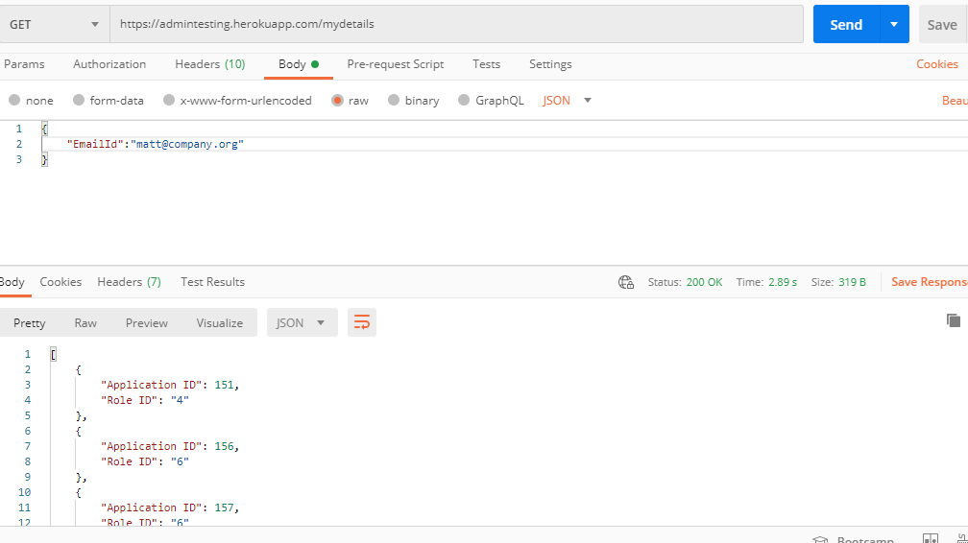
APIs
/mydetails : User can see his Application id and the Role details he applied in that particular Application form.
Balsamiq Tip | Information architecture is the flow of content across the site or application (more info).

Slide 43
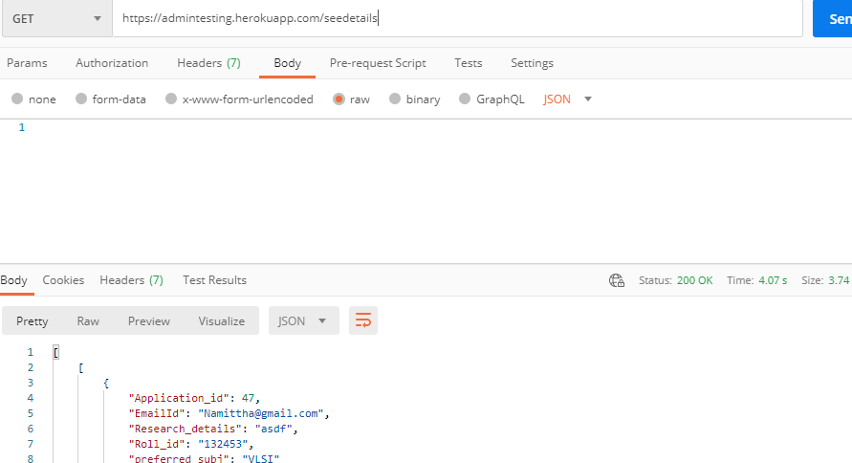
APIs
/seedetails : GETS all details of user from APPLICATION DETAILS table along with his QUALIFICATION, CGPA and DEPARTMENT he qualified in (Admin side).
Balsamiq Tip | Information architecture is the flow of content across the site or application (more info).

Slide 44
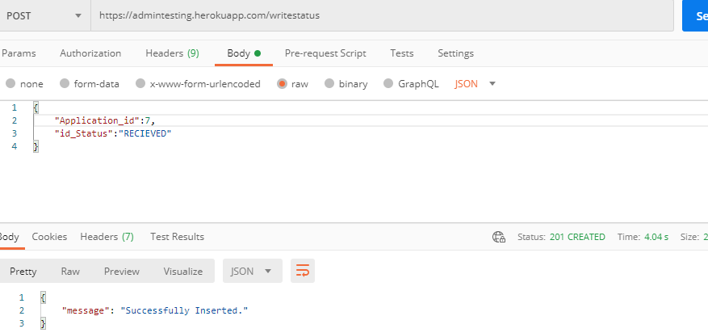
APIs
/writestatus : POSTs status inserted or updated by admin to an application into DB.
Balsamiq Tip | Information architecture is the flow of content across the site or application (more info).

Slide 45
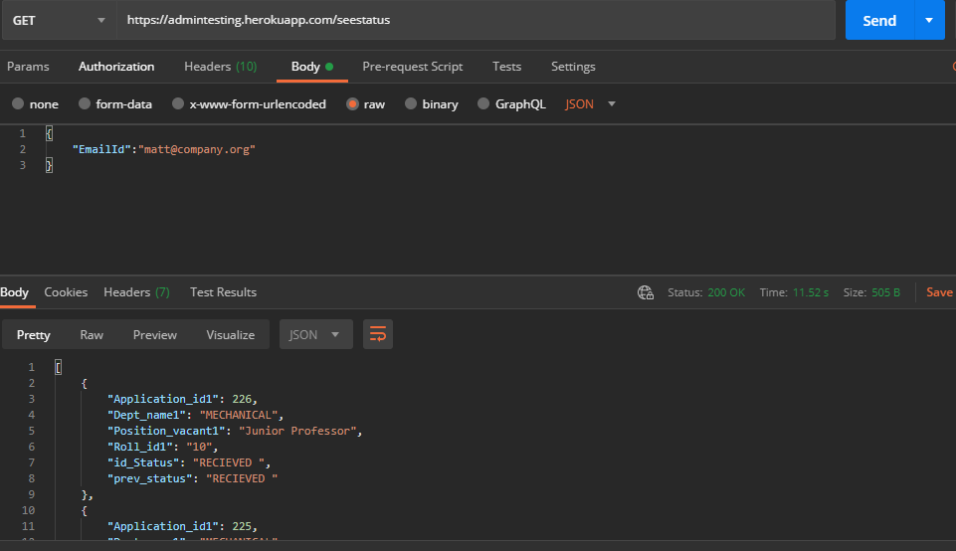
APIs
/seestatus : GETs status written from DB so that user can see the status of his applications.
Balsamiq Tip | Information architecture is the flow of content across the site or application (more info).

Slide 46
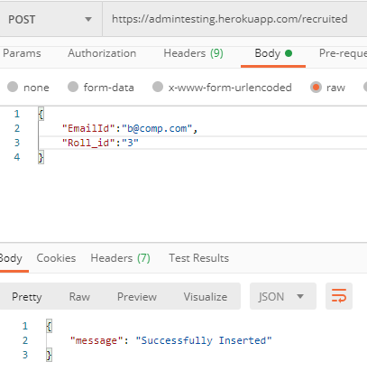
APIs
/recruited : POSTs info of the applicants who were recruited into DB. This API also deletes the applications of the user who is recruited as faculty, it also deletes the ROLE from VACANT ROLES
Table to which the faculty was appointed.
Balsamiq Tip | Information architecture is the flow of content across the site or application (more info).

Slide 47
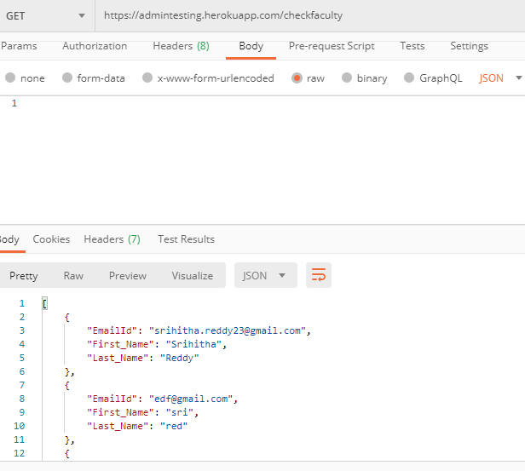
APIs
/checkfaculty : GETs the details of all faculty who are recruited
Balsamiq Tip | Information architecture is the flow of content across the site or application (more info).

Slide 48
Thank You

